Slide 1

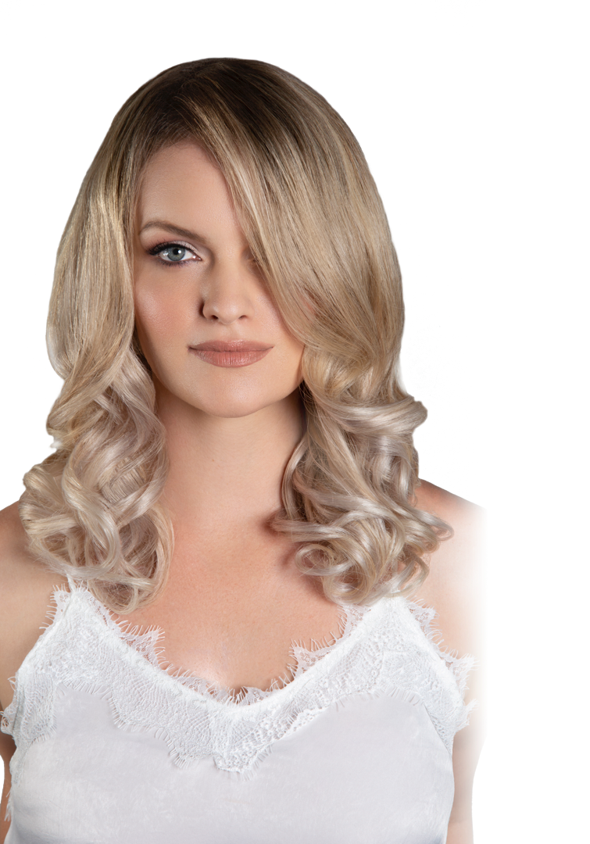

Balayage:
With a Twist
Walk through formulating for beautiful blonds and learn which lightener and toner is right for the look you are trying to create. Leave this class with a better understanding of how lightener works and how to care for the hair before, during and after a lightening service. You will also learn a fun new “twist” on a basic balayage that will add depth and dimension to your blondes.
Tools to bring: 2 bowls, 2 tint brushes,
2 towels, 6 clips, wide tooth comb, highlighting comb, styling brush,
blow dryer, apron
Feb 10th, 2020
10:00am– 2:00pm
Store #0000
14910 Nw Freeway
Houston, Tx 77040
Store # (713-849-0101)
Cost: $40.00
HANDS-ON

